Slide 1
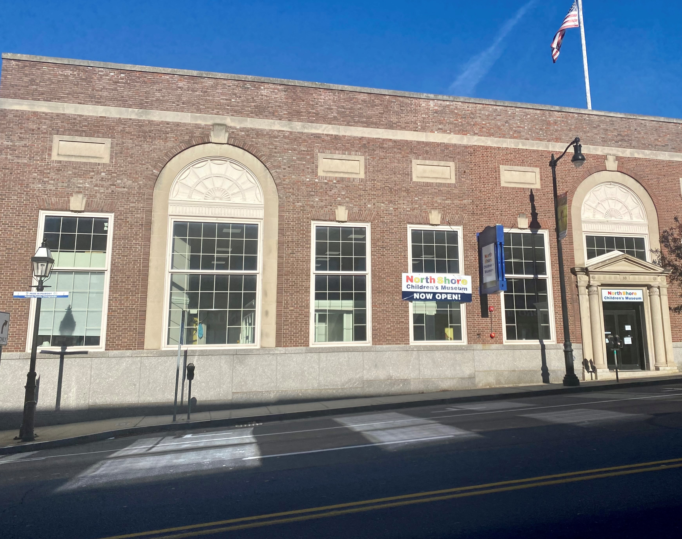

Our Visit to
North Shore Children’s Museum
10 Main Street
Peabody, MA 01960

Slide 2
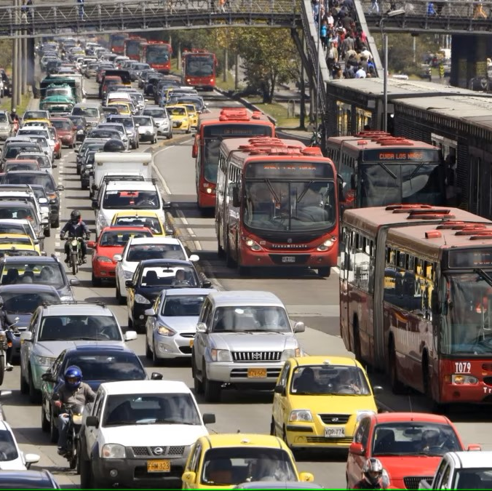
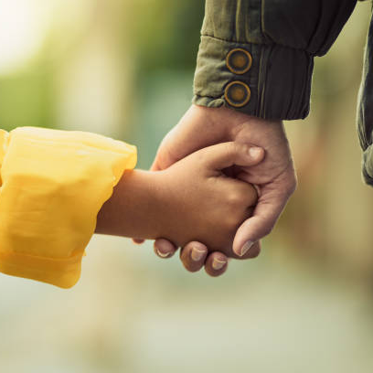
North Shore Children’s Museum is on a very busy road in a city.
The city is called Peabody.
Sometimes the traffic is loud.
Sometimes we have to walk a little way to the museum from our car.

Slide 3
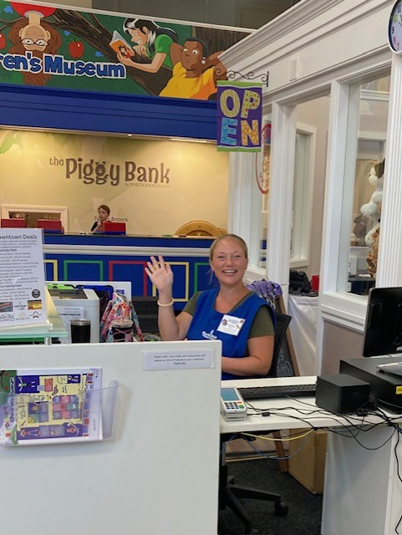
When you get to the museum there may be a line.
We will wait patiently for our turn.
When it is our turn, the person at the front desk will check us in.
The person behind the front desk is called a VEA, which stands for Visitor Experience Associate. There are a few VEA’s in the museum. They wear blue aprons and have a name badge. VEA’s are safe adults always available to help.

Slide 4
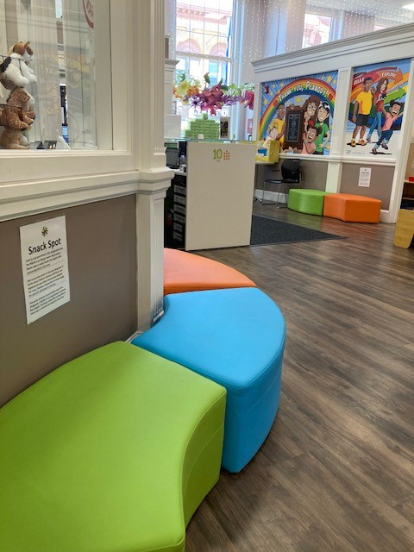
The front desk is in the lobby.
The lobby is a place where we can go for a little break.
It is also a place you can find a VEA who will help you when you need them.
In the lobby we can eat snacks and have a drink. This is the only place in the museum where we can eat and drink.
Subtitle

Slide 5
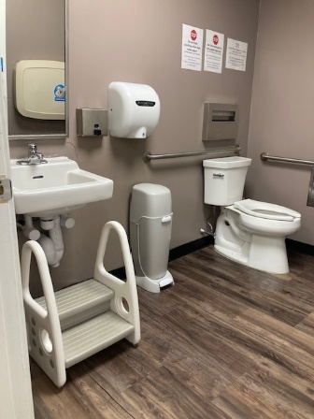
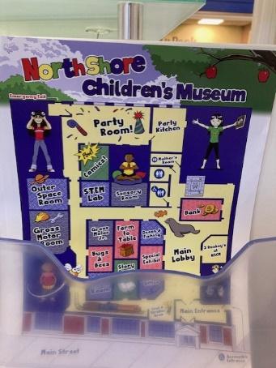
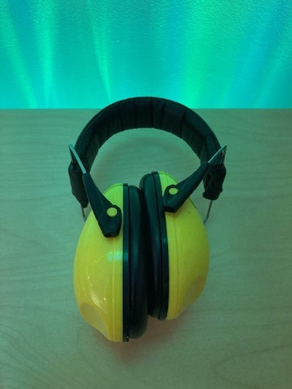
Before we go and play, is there anything else you need?
Do you need to use the bathroom?
Would you like to see a map?
Would noise reducing headphones help today?

Slide 6
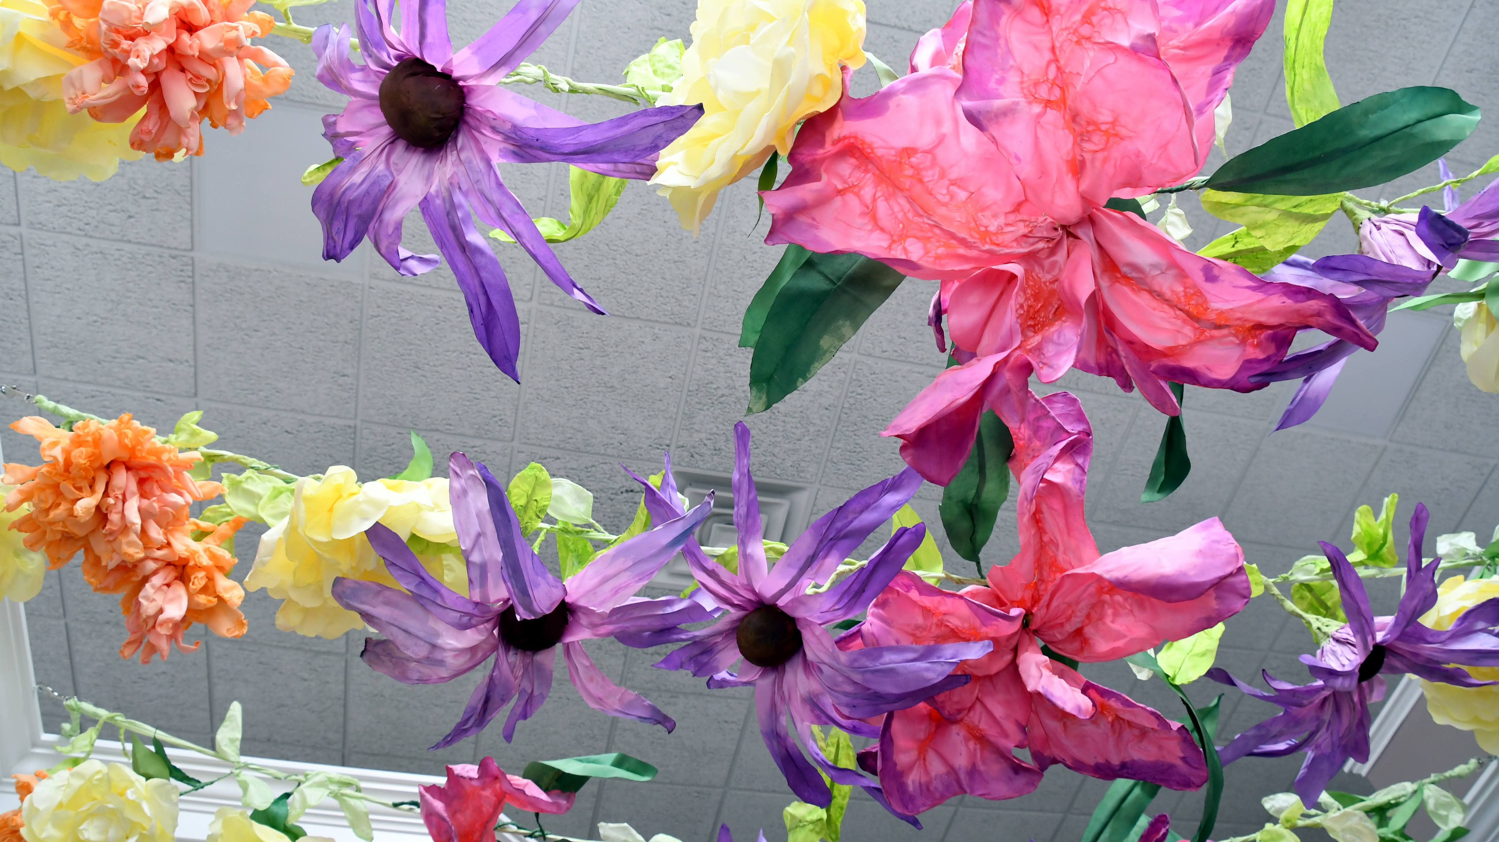
Things to Remember
It will be fun to try new things.
We may meet new friends.
Sometimes you will need to share.
Use kind words
Walking feet are the safest feet.
We can choose what to do at the museum.

Slide 7
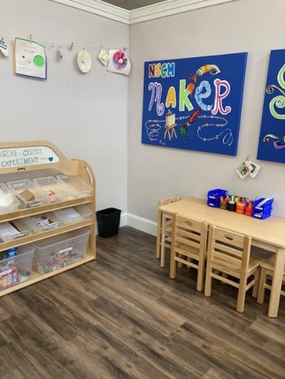
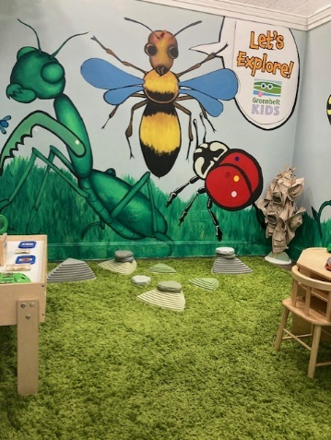
It’s time to explore!
There are lots of exhibits in the museum, each one in its own smaller space.
THE BUG ROOM
Come on in and learn more about insects and bugs. If you would like to you can put on a pith helmet, be an explorer. You will find magnifying glasses too, to help you see.
THE MAKERSPACE
This room is here for you to use your creativity. If you like to glue or tape things, great! If you don’t like sticky stuff there are lots of options here for you to build and design your very own creations.
What might you make in the makerspace?

Slide 8
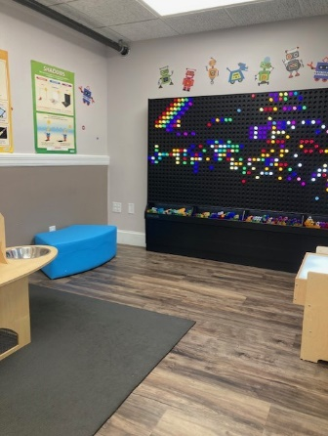
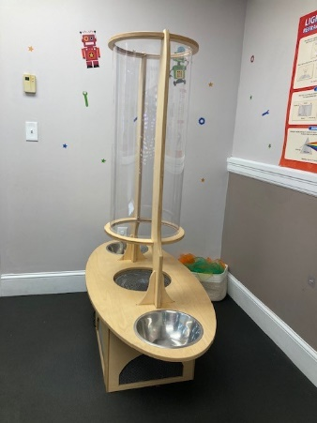
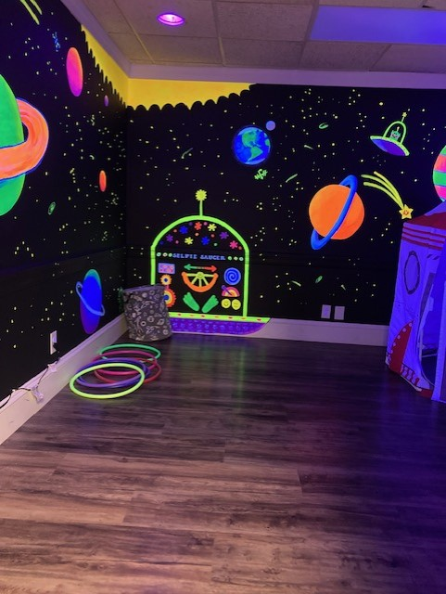
THE SPACE ROOM
It is darker in the space room. With the lights off we can see the fluorescent paint. Make sure to look at your shoes and your clothes, they may light up in the dark. If you like to dress up, you can put on a space suit and visit our rocket ship
THE STEM ROOM
This room is also a little darker so that we can see the fluorescent tubes in the giant lite brite. There is a light table, if it’s too bright we can turn it off, just ask! You will also find a wind machine on our stem room. It sounds just like a fan.
Watch the scarves fly!

Slide 9
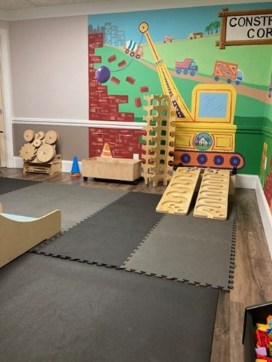
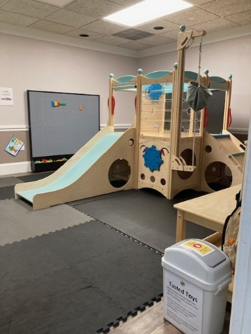
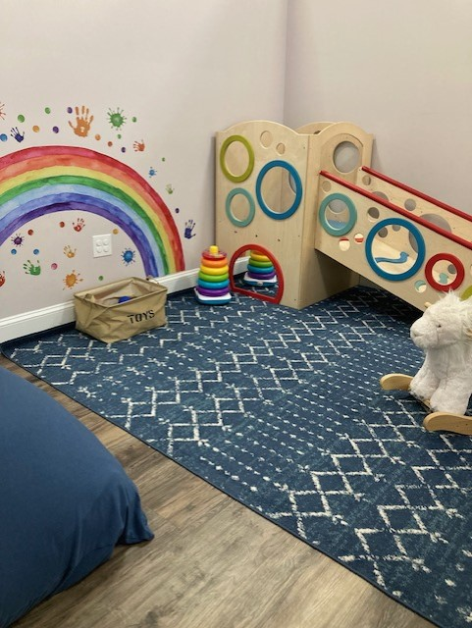
THE GROSS MOTOR JR. ROOM
This room is where younger friends can safely explore and climb and use their big muscles. We ask that you take off your shoes to go in this room because many of the children who play in here are still learning how to walk. Some of these children are babies. You may hear a baby cry while you are visiting the museum. It’s OK.
THE GROSS MOTOR ROOM
Did you know that Gross Motor means big muscles. In this room you can really get a work out. Sometimes it can get a little noisy in here, especially if someone is busy building. There are also a lot of things in this room that let you experiment with motion.
Remember, you may have to take turns.

Slide 10
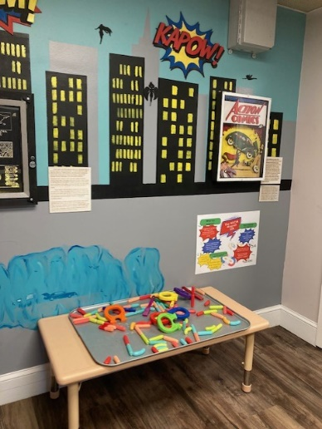
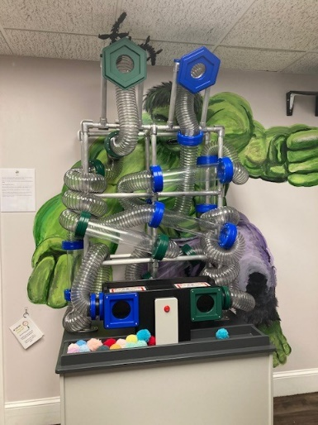
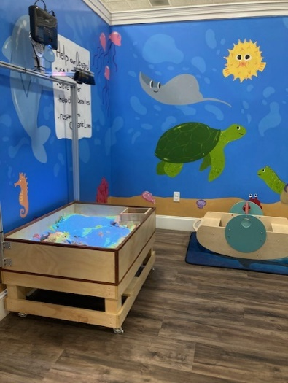
OCEAN ROOM
Sand, sand, sand! Sometimes there will be sand all over the floor. It is because the visitors to the museum are having fun playing in the topographical sand table. Children enjoy drawing sea creatures on the interactive TV, only one finger is needed. If you like to rock you can row, row, row the boat.
THE COMIC BOOK ROOM
Do you have a favorite super hero? Do you have your very own super power? Put on a cape and or a mask if you want to. In our comic book room, there is a quiet space to draw and explore the power of a magnet. There is also a wind machine in here. It is just like the tubes you might see at a bank. It sounds very much like the wind machine in the STEM room except this one starts and stops at the push of a button. Beware the little fluff balls shoot out of the top. The fluff balls are very soft.

Slide 11
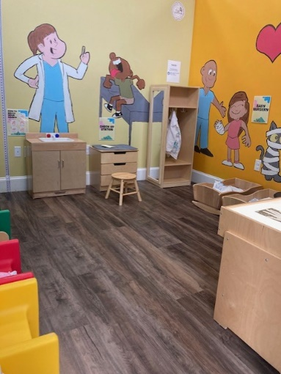
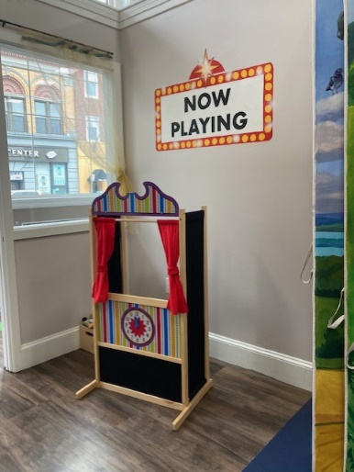
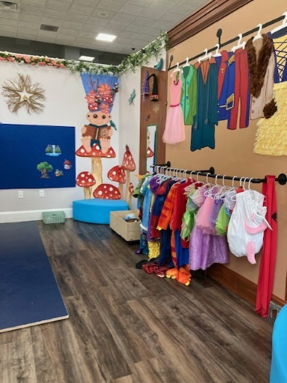
THE STORY BOOK ROOM
There are so many ways to tell a story. In this room you can tell a familiar story or create your very own. There are costumes. Some days we feel like dressing up and other days we don’t. That’s ok. Maybe you can tell your story with puppets. You can also tell a story using the felt board. If you just feel like listening, there is a giant story book to read.
DOCTORS OFFICE
Sometimes it is good to talk about visits to different places so that you can tell people how certain places make you feel. It’s also fun to tell people about things that have happened to you. A doctor is a good person to talk to. In the museums doctor's office, you will meet Betty Bones, a friendly skeleton.

Slide 12
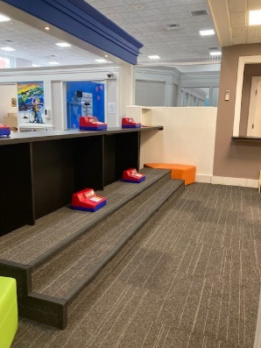
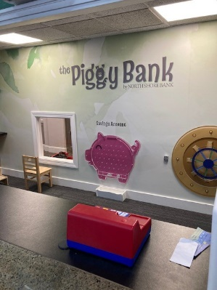
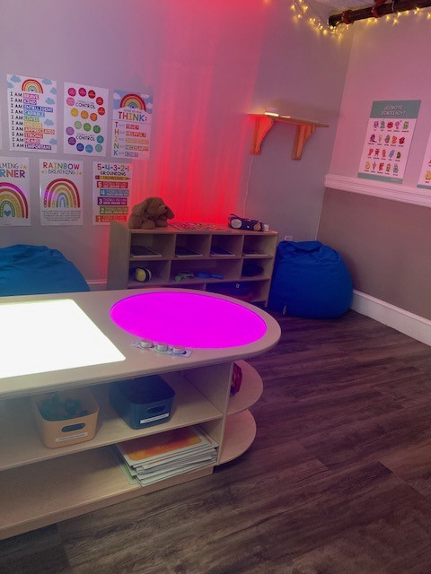
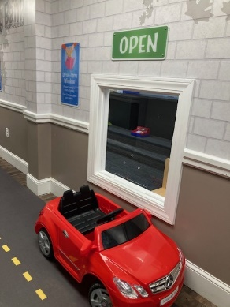
THE SENSORY ROOM
Soft music, calming lights, comfy bean bags, and activities to soothe. Maybe take a few minutes to enjoy this sensory space or ask your grown-up to read something from our emotions library.
THE PIGGY BANK
Do you ever go to the bank with your grown-ups? There is always a lot going on at the bank. Lots of different sounds and people. Our bank is a little quieter. The museum’s bank even has a real-life vault. You can touch it and maybe try to crack the code.

Slide 13

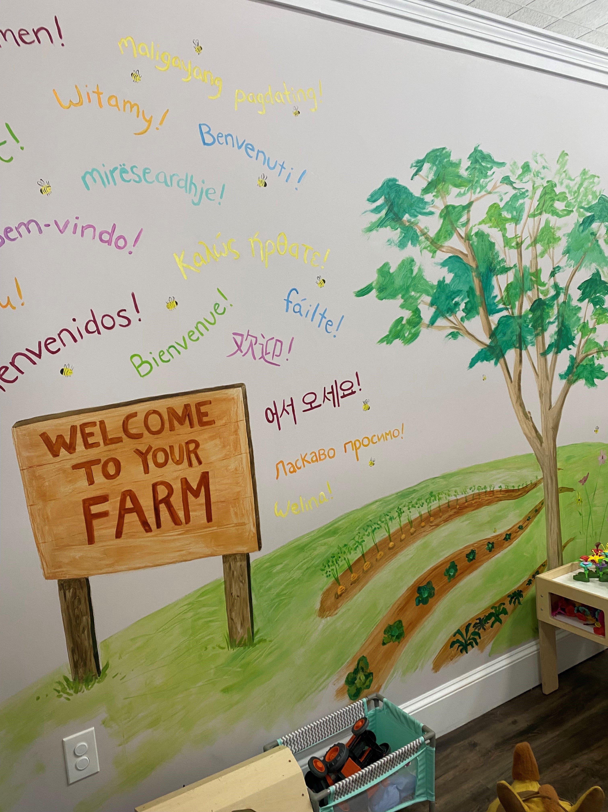
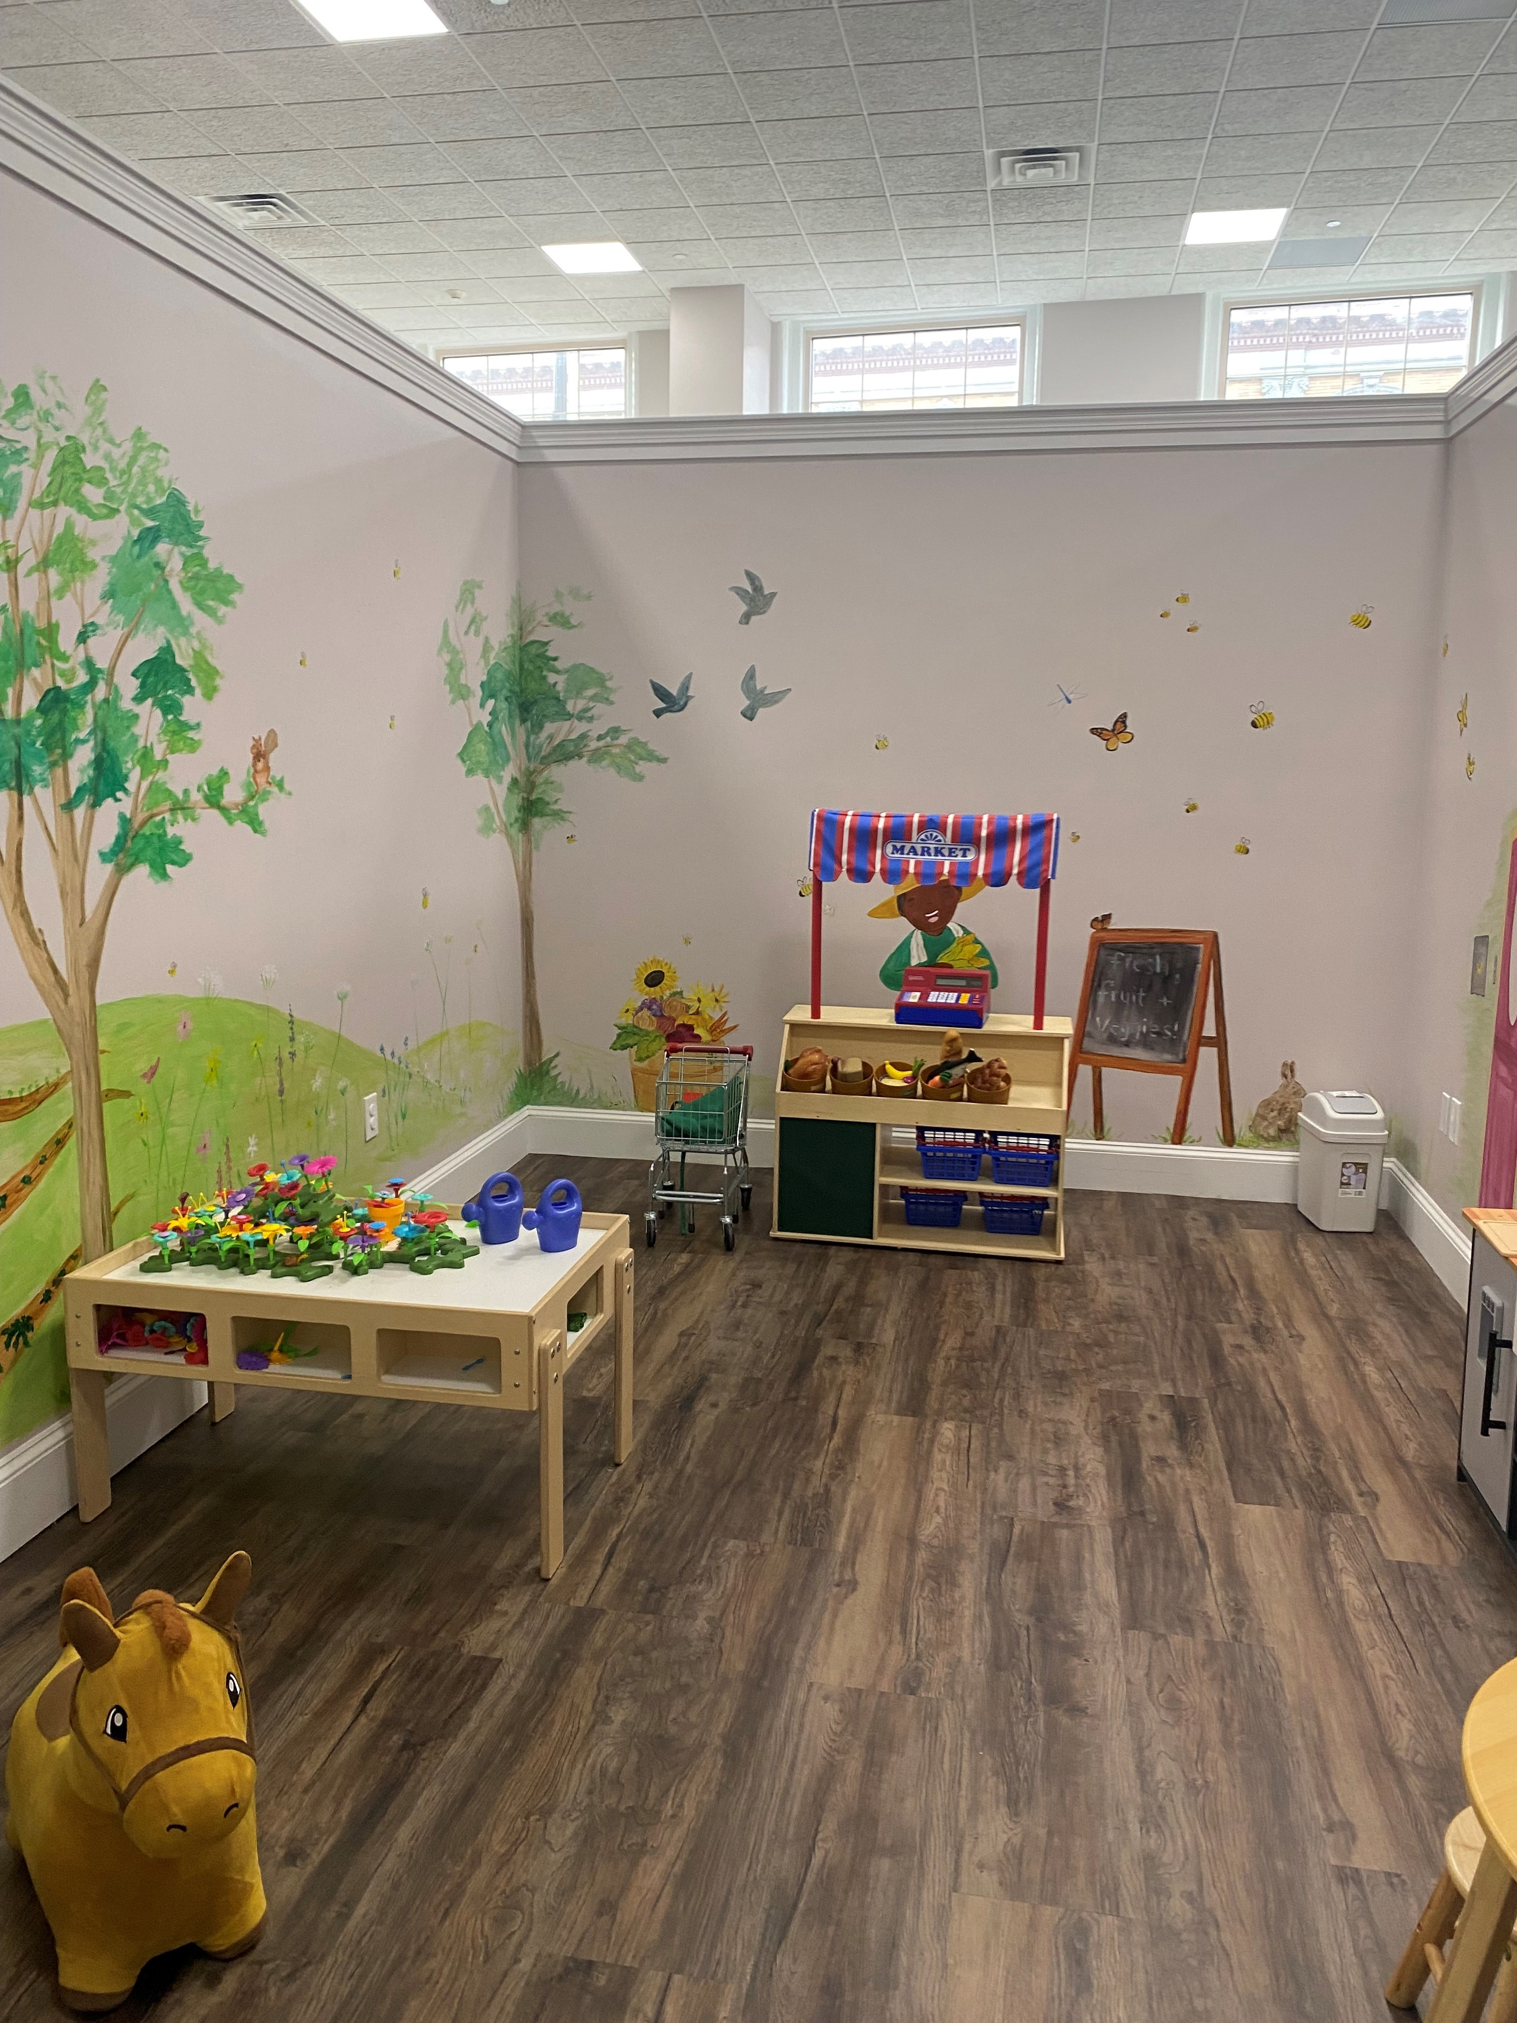
FARM TO TABLE ROOM
This room is one of our most popular rooms. Check it out, see if you like it. There is a lot of things to explore in here, most of them very familiar. You can shop for food and make a meal. You can clean, if you like to clean. There are babies to feed and care for, farm animals too! Farms are very important in our world. So many things that we need are cultivated on farms.
ROTATING ROOM
What will be in this room when we visit?
This room changes with the seasons. The VEA’s and the directors of North Shore Children’s Museum are very creative and enjoy offering new spaces for you to explore. You can call and find out before you visit or just wait and be surprised. Might there be a school room, a post office or maybe a café?

Slide 14
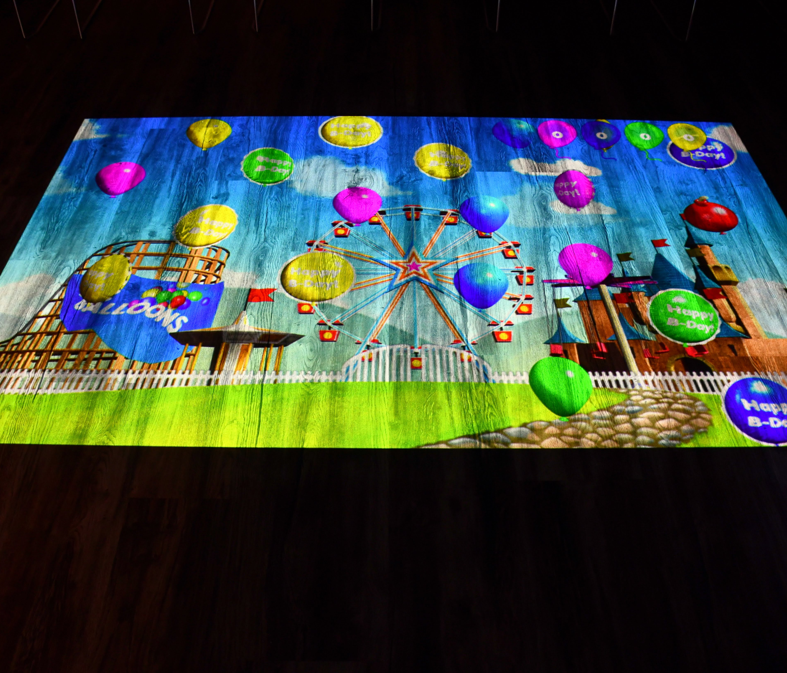
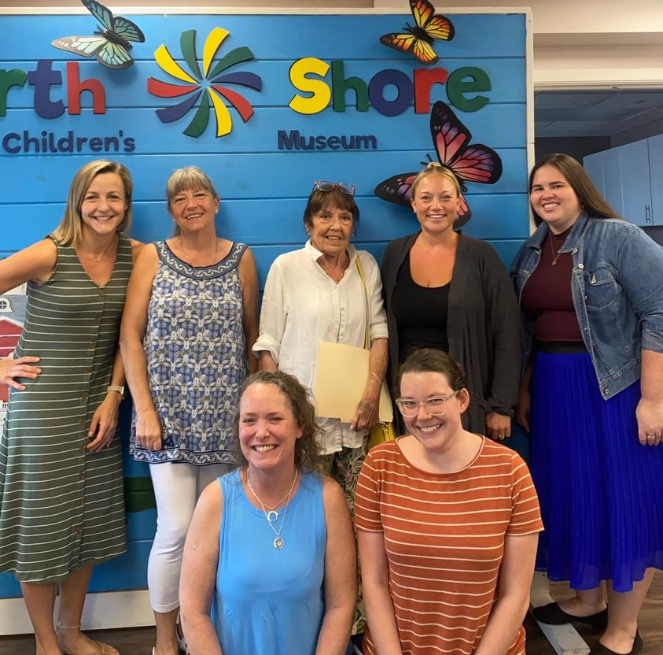
PARTY ROOM
There is one more space, a big room in the back of the museum. It is used for private events so it may be closed when we are at the museum. Or, there may be a special event that we can attend. The museum has some fun workshops.
We could call and ask the VEA’s what is happening in there the day we are going to visit.
If the room is not being used for an event, there is a machine that projects different interactive games on the floor. The volume is set low and they keep the lights off and blinds lowered so that you can see the game better. The beam changes games every few minutes.
Here is the museum team! You may see some of them leading a program in the Party Room.

Slide 15
Well, that wraps up our visit.
We will need to think, is there anything you need to do before we leave?
At the end of the visit, we will leave together as a family. It can feel hard to leave places when you are having fun. Remember you can always come back soon!

